Slide 2
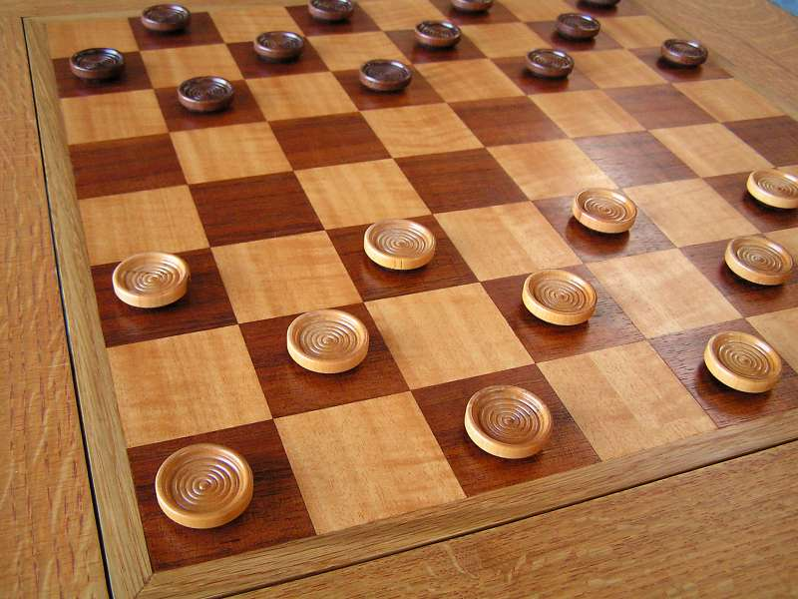
Checkmate
Matthew Chandler
Travis Payton
Kris Dunkle

Slide 3
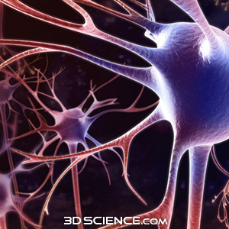
Neural Networks
Is Bigger Always Better?
“We still don’t know if this structure was the best choice, and in fact we’d be disappointed if it were..” (Blondie24, 166)

Slide 4
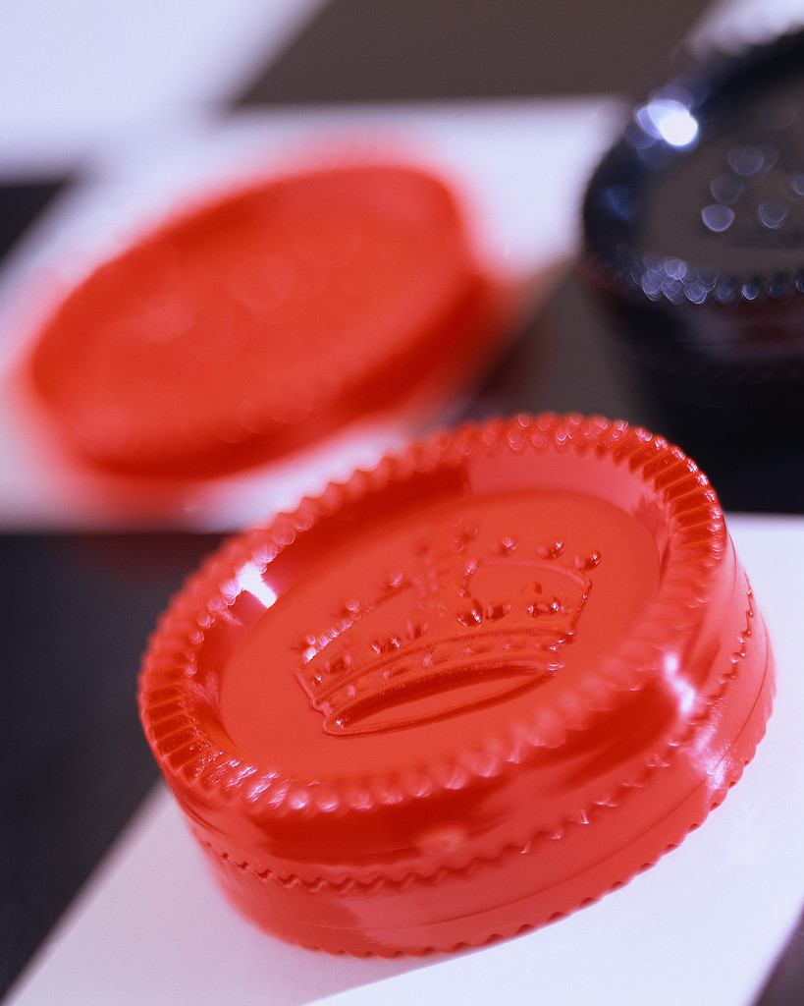
Goals
Train different sizes of Neural Networks and see which ones do better.
Add more information to the input of the Neural Network
…actually make a relatively “smart” checkers playing Neural Net.

Slide 5

Implementation
Round Robin tournament for choosing best networks
Genetic Algorithm for the mutation
Save the best players, and start again.
C++ OOP design
Board Class, CheckersPlayer Class, Genetic Algorithm Class, NueralNetwork Class. OpenGL GUI class. Etc…

Slide 6

Results
Size of Network
Bigger meant longer training
Skill of Networks seemed unrelated to size of Network
Training
Trained over 400 generations for multiple Network sizes.
Each one evolved to a seemingly strong opponent.
Huge differences in the skill from one generation to next.
Skill of Networks
Able to beat average human players.
Ability seemed to differ depending on if it went first or second.

Slide 7

Things we would Change
Focus more on the evolution than the speed of the training
Use a better control to gauge the performance of each generation
More complex fitness ranking based on performance.

Slide 8
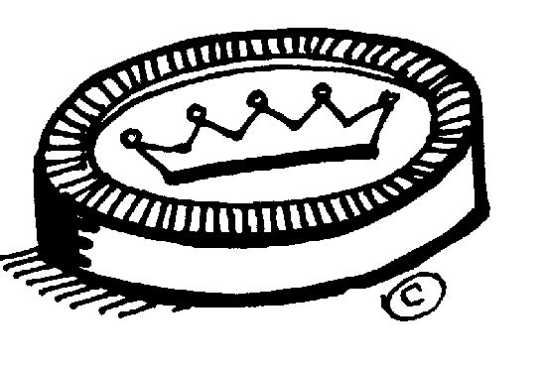
Thanks
For
Listening

